Slide 1


Loan Default Prediction
Final Report
Thanigaivel Dayanandan
Data Science Career Track - Capstone Project #1
2019

Slide 2
Table of Contents
Problem Statement
Data Collection
Exploratory Data Analysis
Machine Learning
Conclusion

Slide 3

Section 1:
Problem Statement
MAJOR REASONS
Most Profitable Loan for the banks
Delinquency rate higher than other loans
Credit risk management practices for home equity lending have not kept pace with the product’s rapid growth

Slide 4
Section 2:
Data Collection
The data set reports characteristics and delinquency information for 5,960 home equity loans.
The data was obtained from the website http://www.creditriskanalytics.net in csv format.

Slide 5
Section 3:
Exploratory
Data Analysis

Slide 6
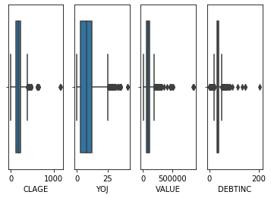
HANDLING OUTLIERS

Slide 7
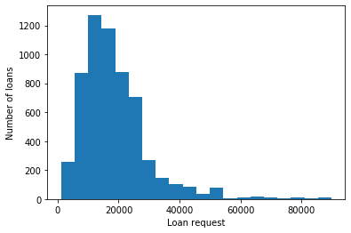
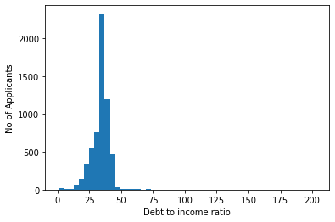
HISTOGRAM

Slide 8
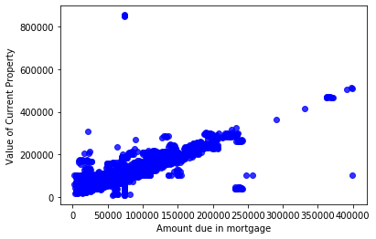
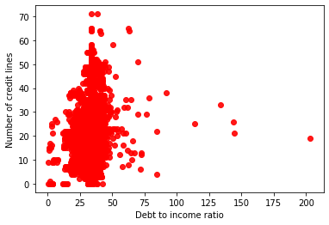
BIVARIATE VISUALIZATION

Slide 9
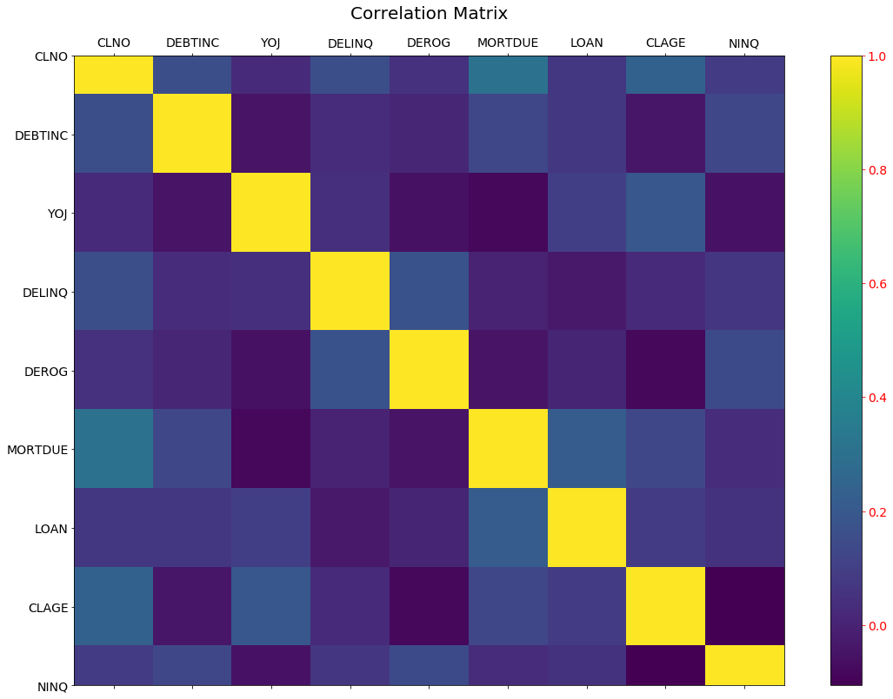
CORRELATION

Slide 10
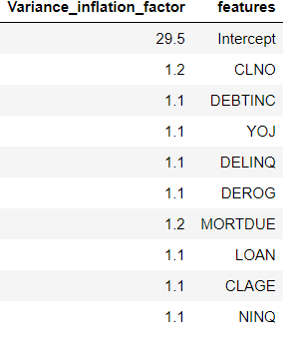
ATRRIBUTE RELEVANCE ANALYSIS
ATTRIBUTE | IV SCORE
LOAN | 0.71
MORTDUE | 0.29
VALUE | 0.69
REASON | 0.01
JOB | 0.08
YOJ | 0.11
DEROG | 0.35
DELINQ | 0.49
CLAGE | 0.39
NINQ | 0.17
CLNO | 0.16
DEBTINC | 1.06

Slide 11
Section 4:
Machine Learning

Slide 12
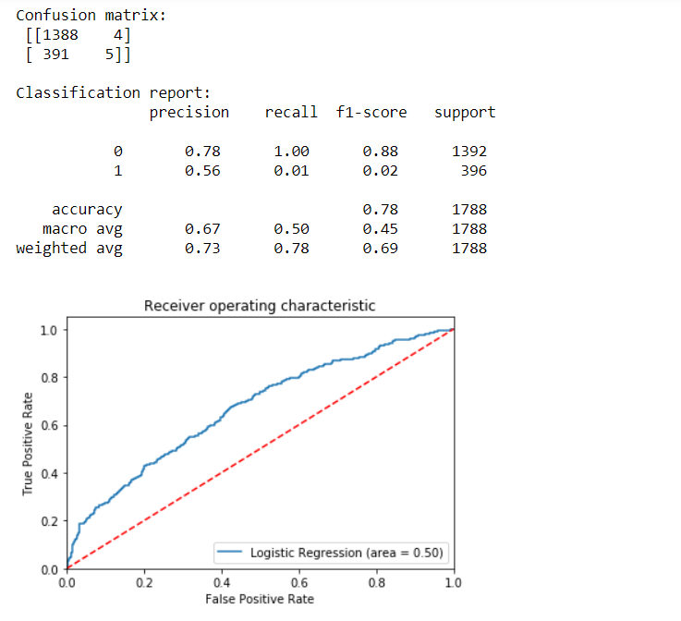
Logistic Regression

Slide 13
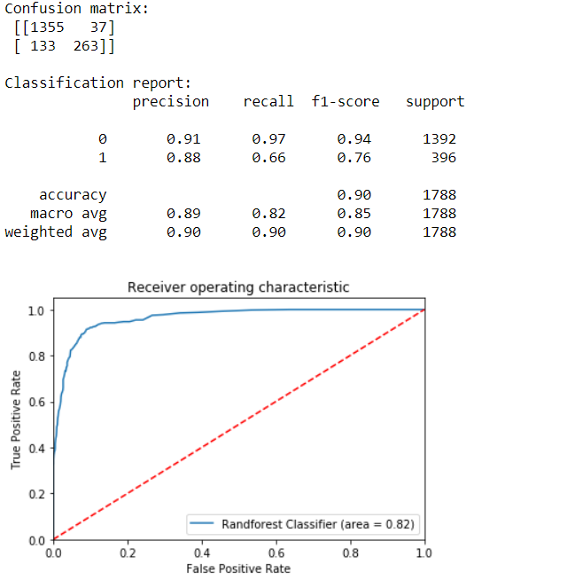
RANDOM FOREST

Slide 14
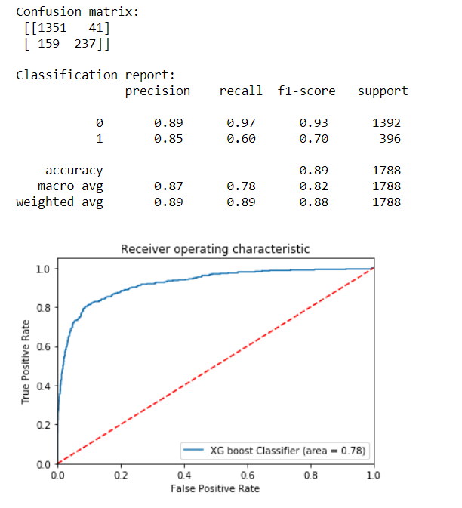
GRADIENT BOOSTING

Slide 15
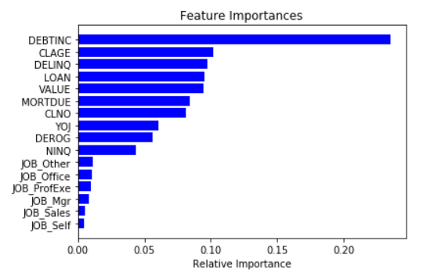
FEATURE IMPORTANCE
Notes:
Linear Regression - MPM
t2_sat_area(microns2) = 2.514793e-04
int_s_avg_5(counts/ms) = 1.243470e-04
Random Forest - MPM
Tree = 3
t2_sat_num(-) = 0.64
int_s_p(counts/ms) = 0.33

Slide 16
Section 5:
Conclusion

Slide 17
Conclusion
Apply the RandomForest classifier model with updated hyperparameter values to predict the potential loan defaulters.
Supports existing Risk management which is essential to mitigate the risk.

